Slide 1
CO2301 - Games Development 1
Week 5
Deriving a "look at" function + Graph Theory
Gareth Bellaby

Slide 2
Topics
Test for "to right", "to left" or "straight ahead".
Cross product
Deriving the local x-axis to test for "to right", "to left" or "straight ahead".
Using cross produce for collision detection
Derive a "look at"/point at function
Graph Theory

Slide 3
Topic 1
Test for "to right", "to left" or "straight ahead".

Slide 4
To right or left?
Consider the situation where the rotation of the gun takes time. The gun needs to rotate in order to point at the target, rather than just being able to point directly at it.
You need to calculate whether the target is to the left, to the right or straight ahead.

Slide 5
To right or left?
You may have direct access to the local x-axis of the gun, e.g. in the TL-Engine. If this is case then this is similar to the first test. However, you employ the local x-axis in place of the z-axis.
  x is the gun's x-axis.
  w is the vector from the gun to the target.
  x • w > 0 if the target is to the right
  x • w = 0 if the target is straight ahead.
  x • w < 0 if the target is to the left

Slide 6
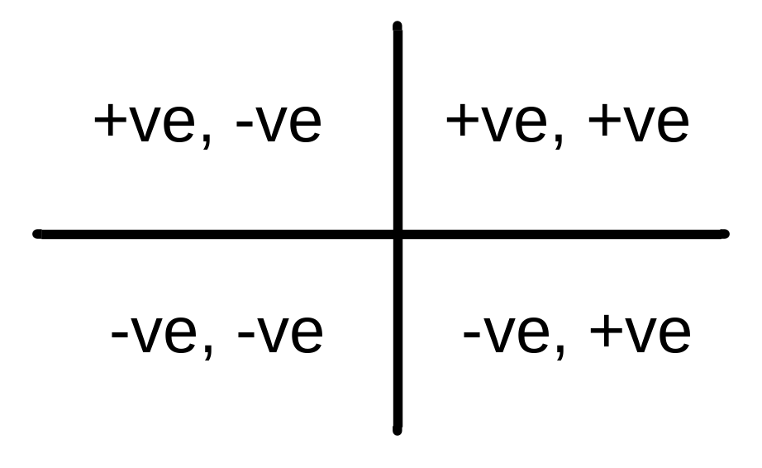
To right or left?
If your combine both of the tests then they can be used to identify which quadrant a target lies in relation to the guard (or gun, or whatever...)
Note: we've also got the maths now for testing whether two vectors are orthogonal to one another, or parallel... this will turn out to be useful

Slide 7
Topic 2
Cross product

Slide 8

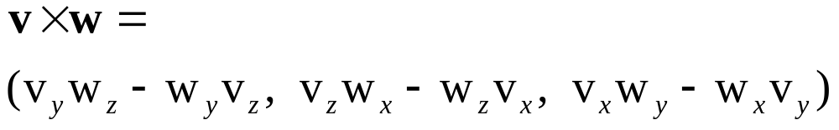
Cross Product
The cross product takes its name from the symbol used: a single cross between two vectors.
Pronounced "The cross product of v and w", or "the cross of v and w ".
The cross product takes two vectors and produces a single vector as its result.

Slide 9
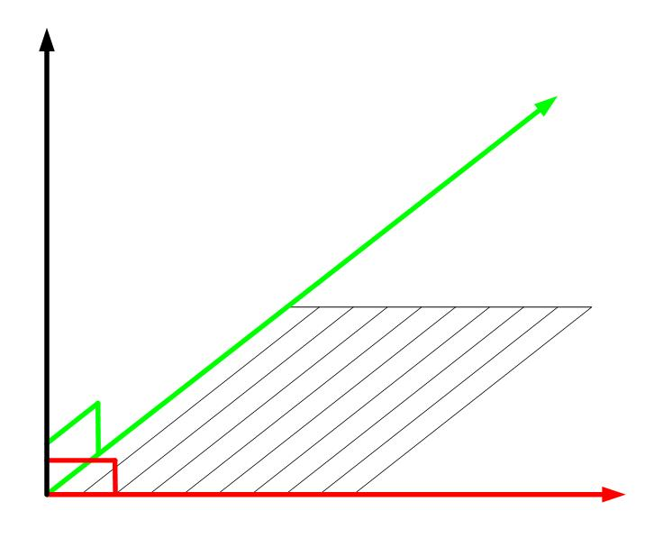
Cross Product
Cross Product
Vector v
Vector w

Slide 10
Cross Product
The cross product of two vectors is the vector which are orthogonal (perpendicular or at right-angles) to both of the vectors.
There will always be two vectors which are orthogonal to our original two vectors: one sticking upwards and the other downwards (relative to the original vectors). The cross product is not commutative. The order of the vectors produces the direction.

Slide 11
Topic 3
Deriving the local x-axis to test for "to right", "to left" or "straight ahead".

Slide 12
Need to derive local x-axis
Do not always have the local x-axis.
The vectors can be many different things. One common instance is that one vector is the current velocity of an object and the second vector is the desired direction of travel.
Also applicable to collision response, e.g. look at this talk:
http://www.essentialmath.com/DotProductFun.ppt
Look at the Van Verth & Bishop.

Slide 13
How?
You have the current velocity of the gun, or you have the current direction in which it is pointing. Call this the facing vector.
How can you calculate the local the x-axis?
Hint: the local x-axis will be orthogonal (at right angles) to the facing vector.
Can use the cross product.

Slide 14
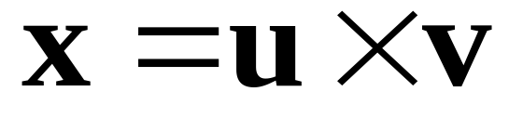
To right or left?
v is the gun's facing vector (or can be velocity).
u is the current up position, e.g. the world Y axis.
d is the desired direction of travel, e.g. the vector pointing towards the target.
Let x be the local x-axis. Then:
Note that the order of the cross product is important. You will get a different result if calculate the cross product of v and u (the sign will be reversed).
However, test will work if you don't normalise.

Slide 15
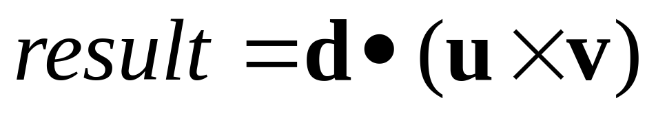
To right or left?
Now we have the x-axis we can perform the second test as before.
d • ( u x v ) > 0 if the target is to the right
d • ( u x v ) = 0 if the target is straight ahead.
d • ( u x v ) < 0 if the target is to the left
If the result is zero then the target is straight ahead.
If the result is negative then the target is to the left.
If the result is positive then the target is to the right.

Slide 16
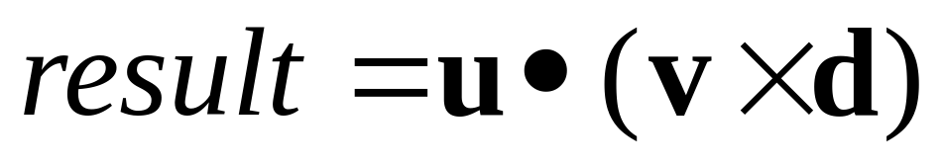
Other ways
As you can imagine, the axes can be derived in many different ways.
The tests can be constructed in different ways as well.
The following test has identical results to the one just given.
Prove that this is the case.

Slide 17
Topic 4
Using cross product in collision detection

Slide 18
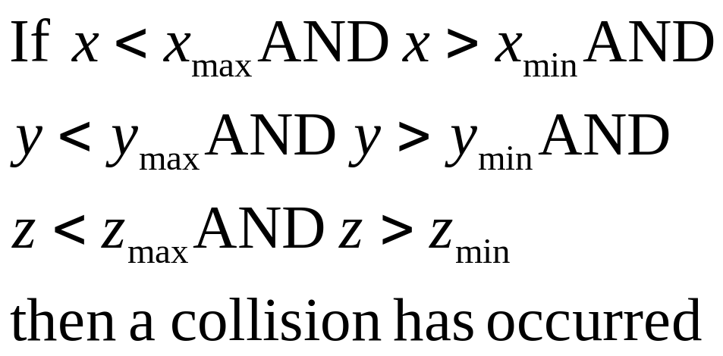
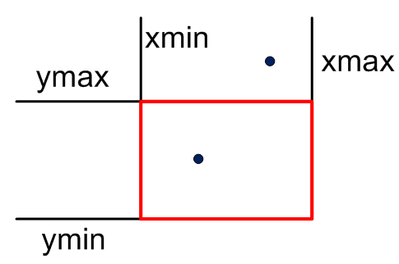
Axis-Aligned Box
Check the position of the point against the minimum and maximum x, y and z values of the box.
A straight forward calculation

Slide 19
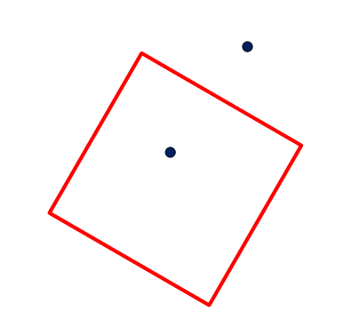
Non-Axis-Aligned Box
But what happens if the box isn't axis-aligned?

Slide 20
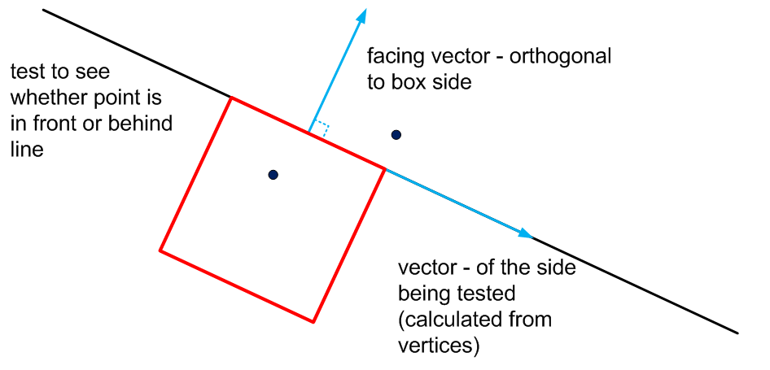
Non-Axis-Aligned Box
Use the test for "in front or behind" and "to right or behind" (4 tests needed)

Slide 21
Topic 5
Derive a "look at"/point at function

Slide 22
Pointing at a target
Targeting is important in computer games: for weapons, but also for chasing and tracking.
You want to construct a "look-at" function.
You have a gun and want to have the model to point at a target.
It is easy to calculate the direction in which to point.
Simply calculate the vector from the gun to the target.

Slide 23
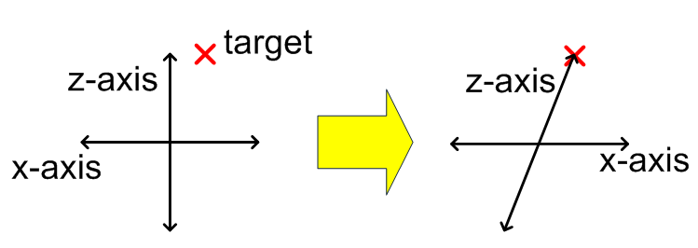
Pointing at a target
The vector from the gun to the target now becomes the new facing vector of the gun, i.e. its local z-axis.
However, there is a problem. What is it?
The other local axes are now wrong.

Slide 24
Pointing at a Target
Need to recalculate the other axes.
Use the cross product in the way already described to calculate the local x-axis.
Then use the local x-axis to calculate the local y-axis.
Note that all of the axes must be normalised.

Slide 25
Making the look-at matrix
Let G be the position of the gun.
Let T be the position of the target.
Let z be the gun's facing vector: the local z-axis.
Let u be the current up position, e.g. the world Y axis.
Let x be the local x-axis.
Let y be the local y-axis. Then:

Slide 26
Making the look-at matrix
Calculate the facing vector (z) from position of the gun and the target.
Use the cross product to derive the other axes.
Derive the local x-axis (x) from the cross product of UP (the world Y axis) and z.
Derive the local y-axis (y) from the cross product of z and x.
All of the axes must be normalised.

Slide 27
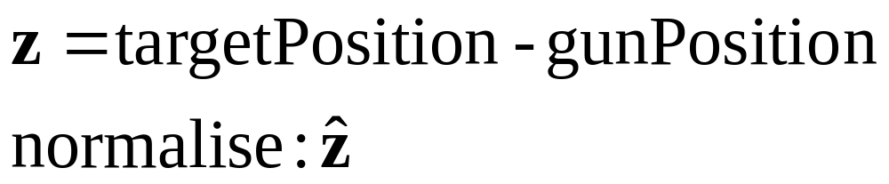
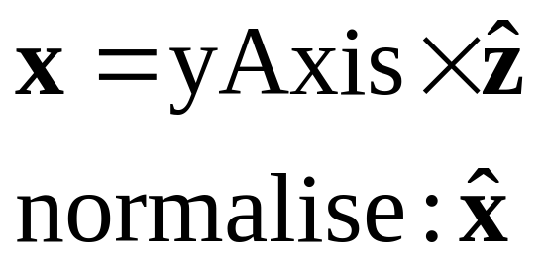
Making the look-at matrix
Derive the facing vector then normalise it.
Derive the x-axis
If the derived vector is orthogonal to the facing vector and orthogonal to the yAxis (the Up vector), then it must be the x-axis.

Slide 28
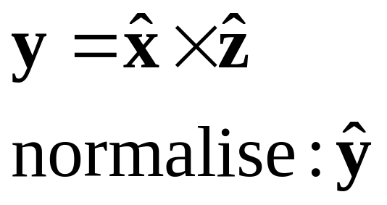
Making the look-at matrix
Derive the local y-axis.
In this case the resulting vector is orthogonal to z and x and so must be the local y-axis.
Why are the vectors normalised?

Slide 29
Pointing at a Target
// Calculate targeting matrix axes for gun
// Get facing (z) vector from positions
CVector3 vecZ = Normalise( Subtract( targetPosition, gunPosition ) );
// Use cross products to get other axes
// Must normalise axes
CVector3 vecX = Normalise( Cross( kYAxis, vecZ ) );
CVector3 vecY = Normalise( Cross( vecZ, vecX ) );
// Build targeting matrix from axes + position
// Matrix constructor using four CVector3 variables
// - one for each row/column
// (see matrix header)
// Build targeting matrix by row (axes + position)
CMatrix4x4 gunMat;
gunMat.MakeIdentity();
gunMat.SetRow( 0, vecX );
gunMat.SetRow( 1, vecY );
gunMat.SetRow( 2, vecZ );
gunMat.SetRow( 3, gunPosition );
// Set position of gun using matrix
gun->SetMatrix( &gunMat.e00 );

Slide 30
Pointing at a Target
The facing (z) vector has been derived. The front of the gun is pointing towards the target. If you were going to derive other movements it might not be UP that you need.
The calculations have derived the other axes, but ignored their relative standing to the world. When we use this method to chase a target, you will see that the chasing body may turn upside down or do a roll. We've only considered the front of the gun, not it's other axes.

Slide 31
Topic 6
Graph Theory

Slide 32
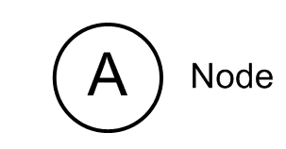
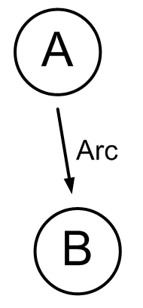
Graph Theory
A graph is composed of nodes, (alternatively called vertices)
  drawn as circles
  labelled
The nodes are connected by edges (alternatively called arcs)
  drawn as lines between the nodes.

Slide 33
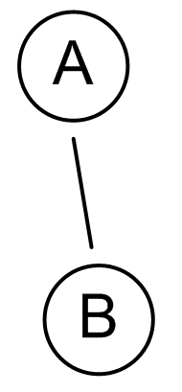
Edge orientation
An edge may have no orientation.
In this case the edge is undirected. Draw an line with no arrows.

Slide 34
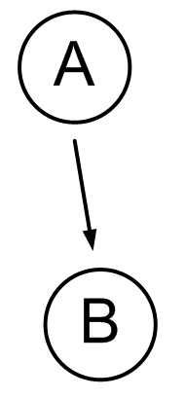
Edge orientation
An edge may have an orientation.
In this case the edge is directed.
Drawn using an arrow. The arrow head shows the orientation
Graphs can be a mixture of undirected and directed. (We'll mostly be considering directed.)
By convention a graph with directed edges is drawn pointing downwards

Slide 35
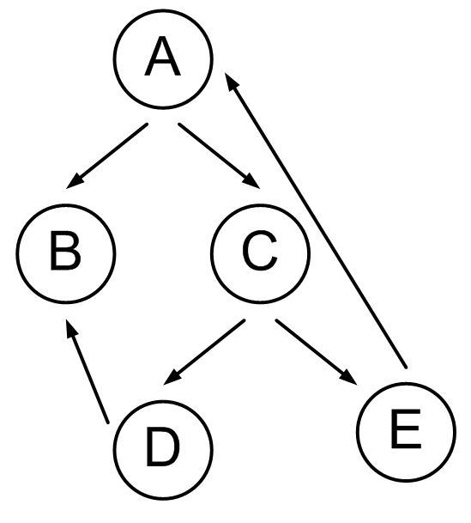
Repeating nodes
A graph may connect back to itself: cyclic

Slide 36
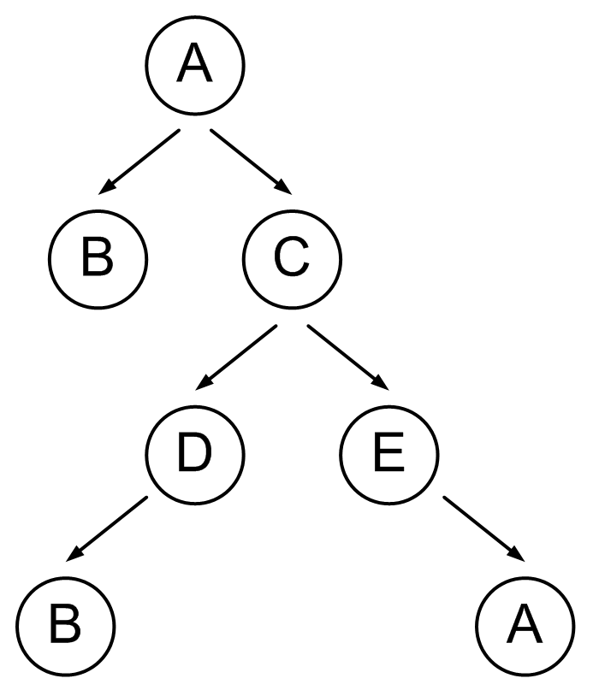
Repeating nodes
You will be more likely to see the diagram in this form, i.e. repeating nodes.
One of the things I'll talk about in pathfinding is the removal of repetition.

Slide 37
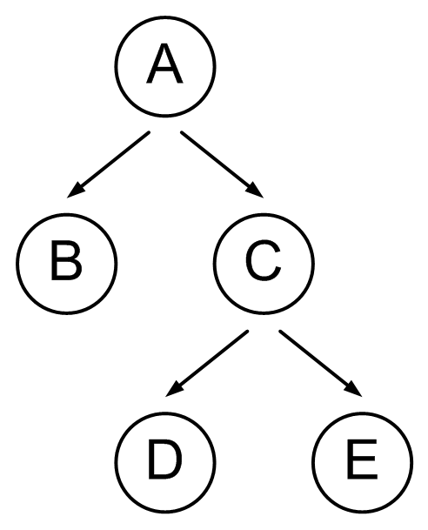
Acyclic graph
A graph may have the property that it never connects back to itself: acyclic.
Once we remove repeating nodes this is the type of graph we'll end up with.

Slide 38
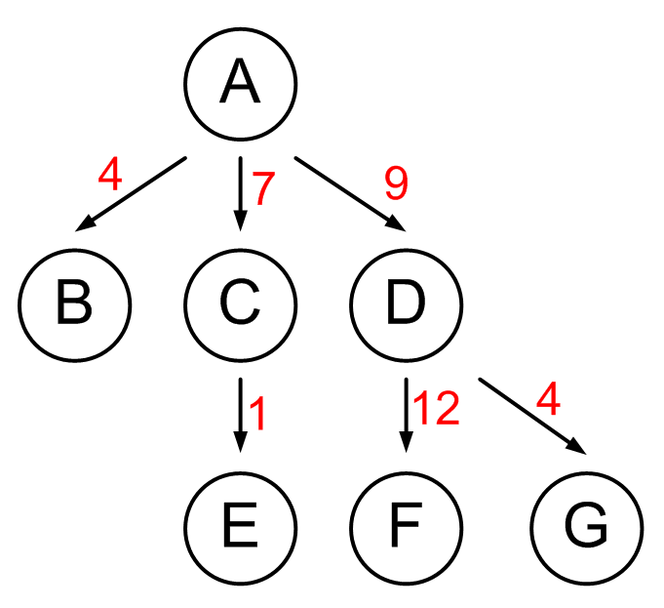
Graph Theory
A weighted graph is one where each edge has some associated value.

Slide 39
Graph Theory
(A,B)
(A,C)
(C,D)
(C,E)
If the edges are directed then the edges of the graph can be treated as ordered pairs, e.g. (a, b). The graph itself would be the set of ordered pairs.
The edges of an undirected graph are unordered pairs, so the graph would be the set of adjoining edges.
Considering the edges as pairs, and whether the pairs are ordered or ordered will be useful when you come to do the programming.

Slide 40
Examples
Problems in graph theory. There are lots of different problems. The ones were mostly interested in are:
  Route problems. This is what we're interested in for path finding. specifically Graph searching problems or graph traversal
  Sub graphs. Graphs which are part of a graph.

Slide 41
Examples
Locations on a map.
Location turned into a graph
Movement is from start to goal. Treat the edges as directed.
Why we do we treat the edges as directed?
Don't want to return to a previous location.
The graph we build is acyclic for the same reason.
In graph theory this category of problem is called "shortest path"

Slide 42
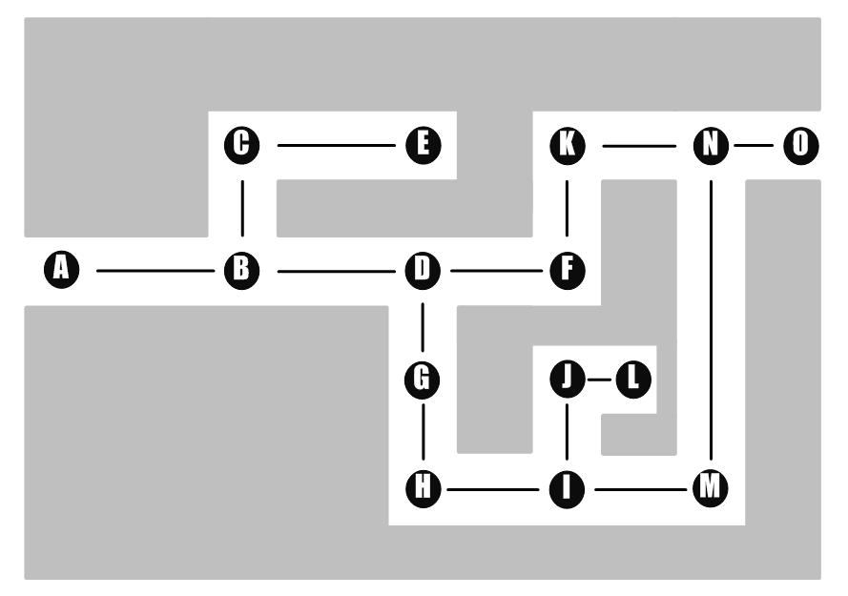
Example: pathfinding

Slide 43
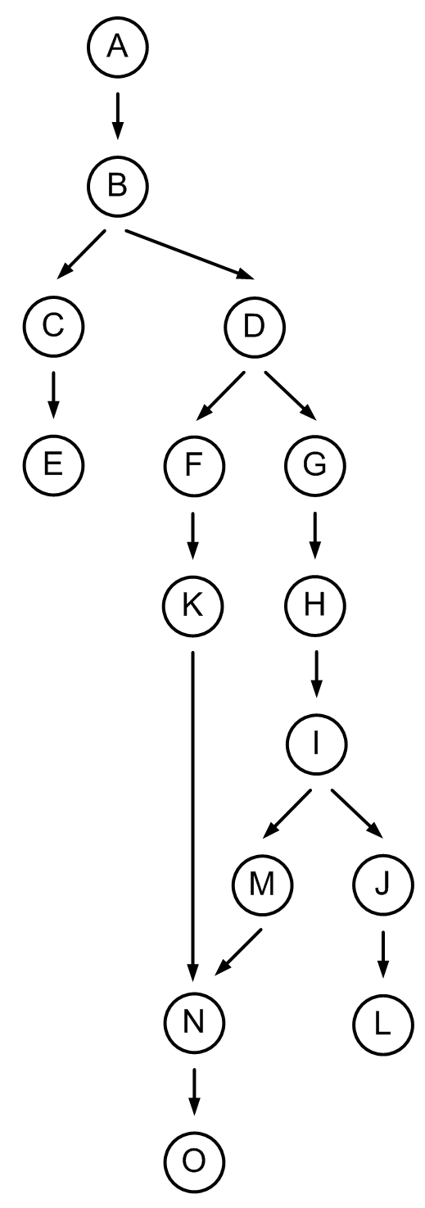
Pathfinding as a graph
Map is treated as a set of waypoint, which are then converted to nodes with directed edges.

Slide 44
Examples
Graphs are also used to model conceptual problems, e.g. planning algorithms in which actions are represented by nodes and the problem converted into a graph
More generally, decision making algorithms for our purposes are often expressed as graphs
A finite state machine is a graph.
We're also interested in efficient graphs, e.g. a minimum spanning tree (a subgraph that connects all of the nodes of a graph together. A minimum one would be the least costly tree).

Slide 45
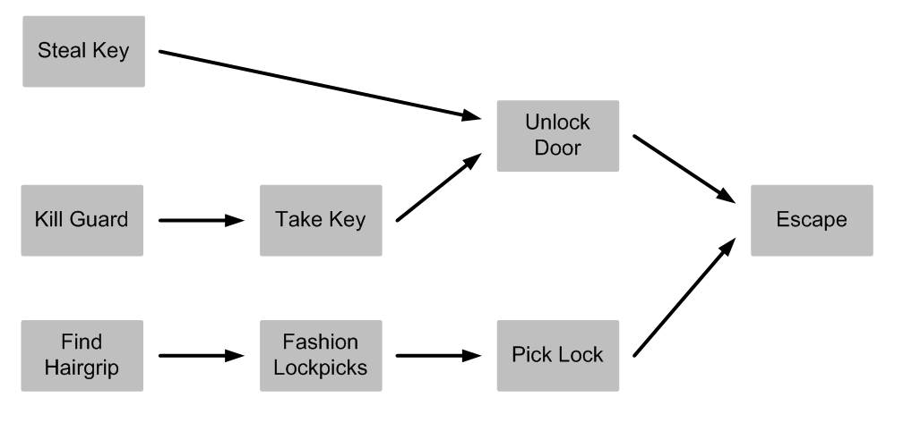
Example: planning
Goal Oriented Action Planning (GOAP). Used in games such as FEAR, Fallout 3, etc.

Slide 46
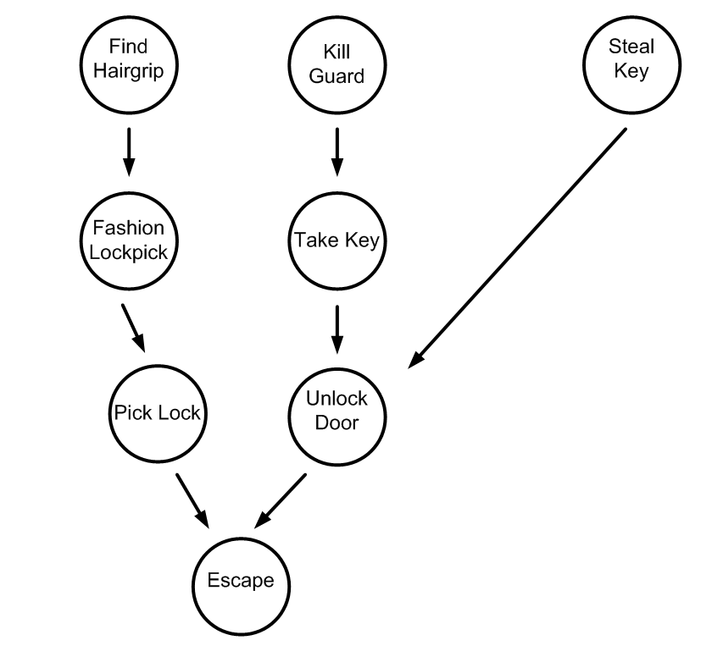
Planning as a graph
Note that this graph forms a tree structure.
Trees are a common data structure within computing

